Slide 1

Database Design Project
A Business Relationship Model
Internally from People to Product
By: Gerard Taliercio

Slide 2
Table of Contents
Executive Summary……………………..3
Part I
ER Diagram……………………………….4
Part II
People Table……………………………..5-6
Contractors Table………………………..7-9
Employees Table………………………...10-12
Division Table…………………………….13-15
Project Table……………………………...16-18
Production Table…………………………19-21
Part III
Joins…………………………………….22-26
Sub-Query……………………………......27
Sum Calculation………………………….28
Group By………………………………….29
Having Clause……………………………30
Create View……………………………….31
Create user, password, grant, revoke..32
Issues and Enhancements ………..…. 33

Slide 3
Executive summary
This document details the database architecture and specification for a business. It will show the hierarchy structure and relational model between employees, their departments, and products being produced..
The first part will detail the layout and relationships between all areas of a company and how they work in harmony.
The second part will examine each area of the business and detail all the members of each object. A series of snapshots and SQL statements will be included for reference.
The third part will demonstrate the capabilities of the business model through many joins, sub-query, having clause, security, grant, revoke, etc.

Slide 4
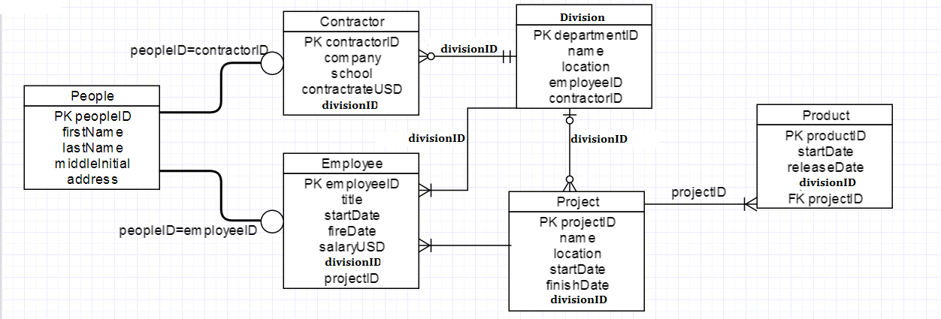
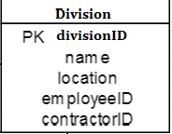
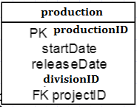


Entity Relationship Diagram
Below is an ER diagram that details the relations between etities in a business model from people to product.

Slide 5
The people table
The people table uses peopleID as its primary key
Functional Dependencies: peopleID firstName, lastName, middleInitial, address
People shows every person who works or has worked for the business. It details their full name and the where they reside.
Create Statement
---------------
-- People --
---------------
drop table if exists people;
create table people (
peopleID char (10) not null,
firstName varchar (20),
lastName varchar (20),
middleInitial varchar (1),
address varchar (20),
primary key(peopleID)
);

Slide 6
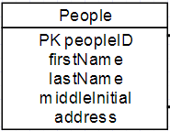
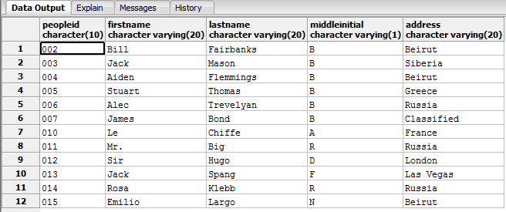
The people table continued
Here is the people object from the ER diagram along with sample data from the created.
Sample Data

Slide 7

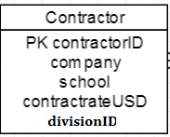
The Contractors table
The contractors table uses contractorID for the primary key.
Functional Dependencies: contractorID company, school , contractrateUSD
Contractors categorizes which person from people is a contracted employee. A person is outsourced from another company and their educational background is stored for reference and proper placement. The annual rate (USD) to which they are paid is also within this table.
divisionID is a reference to which division the contracted employee has been placed.

Slide 8
Contractors Table continued
Here is the create statement for contractors and the sample data created from it.
Create Statement
----------------
-- Contractors --
----------------
drop table if exists contractors;
create table contractors (
contractorID char(10) not null,
company varchar (30),
school varchar (30),
contractrateUSD numeric (12,2),
divisionID char (10) not null,
primary key (contractorID),
foreign key (divisionID) references division (divisionID)
);

Slide 9
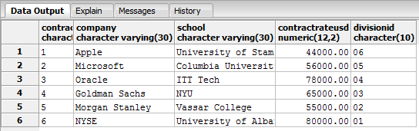
Contractor table continued
Sample Data

Slide 10
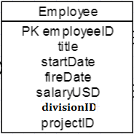
The employees table
This table uses employeeID for the primary key.
Functional Dependencies: employeeID title, startDate, fireDate, salaryUSD
The employee table also references to the division the employee is working in as well as the project they are working on by using the foreign keys: divisionID and projectID

Slide 11
Employee table continued
Create Statement with Check Constraint
--------------
-- Employee --
--------------
drop table if exists employees;
create table employees (
employeeID char(10) not null,
title varchar (26),
startDate date not null,
fireDate date,
salaryUSD numeric (12,2) CHECK(salaryUSD > 0),
divisionID char (10) not null,
projectID char (10) not null,
primary key (employeeID),
foreign key (divisionID) references division (divisionID),
foreign key (projectID) references projects (projectID)
);

Slide 12
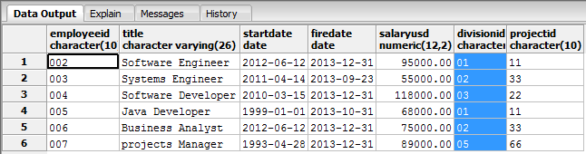
Employee table continued
Sample Data

Slide 13

The division table
This table uses divisionID as its primary key
Functional Dependencies: divisionID name, location
This table utilizes the foreign keys: employeeID and contractorID to display which employee and or contractor works.

Slide 14
Division table continued
Create Statement
-----------------
-- division --
-----------------
drop table if exists division;
create table division (
divisionID char(10) not null,
name varchar (26),
location varchar (30),
employeeID char (10) not null,
contractorID char (10) not null,
primary key (divisionID),
foreign key (employeeID) references employees (employeeID),
foreign key (contractorID)references contractors (contractorID)
);

Slide 15
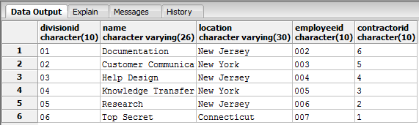
Division table continued
Sample Data

Slide 16

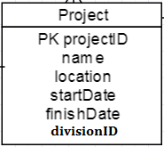
The project table
This table uses projectID as the primary key.
Functional Dependencies: projectID name, location, startDate, finishDate
The project table references each project belonging to a particular division by using the foreign key divisionID.

Slide 17
Project table continued
Create Statement
--------------
-- projects --
--------------
drop table if exists projects;
create table projects (
projectID char(10) not null,
name varchar (26),
location varchar (30),
startDate date not null,
finishDate date,
divisionID char (10) not null,
primary key (projectID),
foreign key (divisionID) references division (divisionID)
);

Slide 18
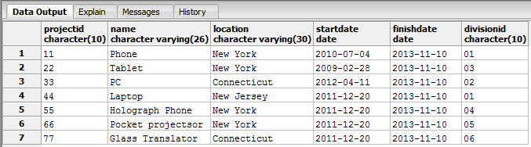
Project table continued
Sample Data

Slide 19
The production table
The production table utilizes productID as the primary key.
Functional Dependencies: produciontID startDate, releaseDate
Foreign Keys: divisionID references which product came from what division
projectID references which product came from what project

Slide 20
Production table Continued
Create Statement
--------------
--Production--
--------------
drop table if exists production;
create table production (
productionID char(10) not null,
releaseDate date,
divisionID char (10) not null,
projectID char (10) not null,
primary key (productionID),
foreign key (divisionID) references division (divisionID),
foreign key (projectID) references projects (projectID)
);

Slide 21
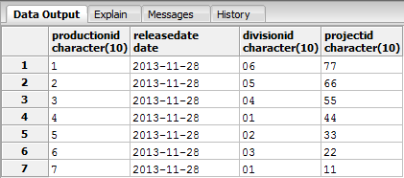
Production table Continued
Sample Data

Slide 22
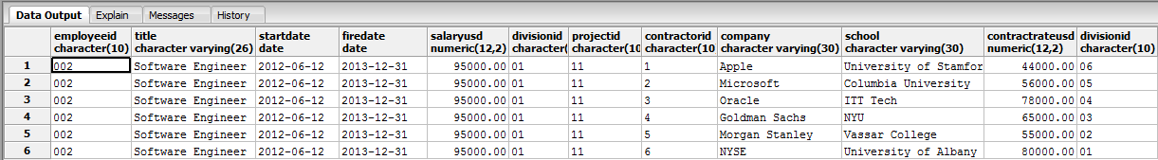
Cross Join
select *
from employees, contractors
where salaryUSD = 95000.00

Slide 23
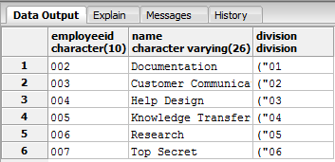
Inner join
SELECT employeeID, name, division
FROM people INNER JOIN division
ON peopleID = division.employeeID

Slide 24
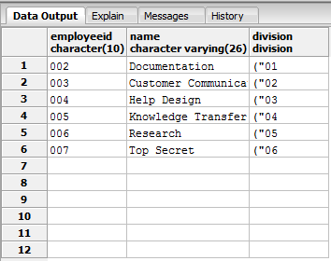
Left Outer Join
SELECT employeeID, NAME, division
FROM people LEFT OUTER JOIN division
ON peopleID = division.employeeID

Slide 25
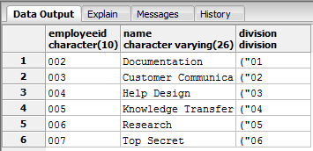
Right outer join
SELECT employeeID, name, division
FROM people RIGHT OUTER JOIN division
ON peopleID = division.employeeID

Slide 26
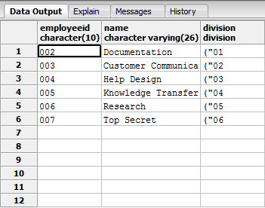
Full outer join
SELECT employeeID, name, division
FROM people FULL OUTER JOIN division
ON peopleID = division.employeeID

Slide 27
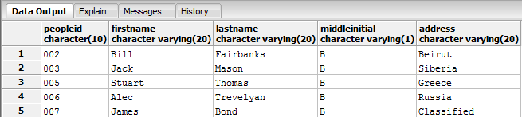
Sub-query
SELECT *
FROM people
WHERE peopleID IN (SELECT employeeID
FROM employees
WHERE salaryUSD < 100000)

Slide 28

Sum calculation
SELECT SUM(salaryUSD) AS cost
FROM employees WHERE startDate
BETWEEN '03/15/2010' AND '06/12/2012'

Slide 29
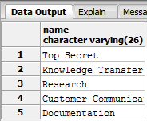
Group by
SELECT name
FROM division
GROUP BY division.name
HAVING name <> 'Help Design'

Slide 30
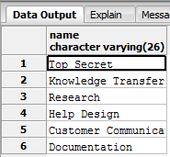
Having clause
SELECT name
FROM division
GROUP BY name
HAVING count(name) < 9

Slide 31
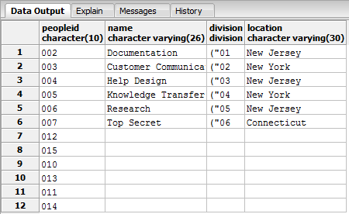
Create view
CREATE VIEW people_view
AS
SELECT peopleID, firstNAME,lastName, address
FROM people;
-----------------------------
select *
from people_view
------------------------------
FULL OUTER JOIN FROM VIEW
------------------------------
SELECT peopleID, name, division, location
FROM people FULL OUTER JOIN division
ON peopleID = division.employeeID

Slide 32
Create user, password, grant, revoke
CREATE USER Alan WITH PASSWORD 'isawesome'
GRANT ALL ON people TO Alan
REVOKE ALL ON COMPANY FROM
CREATE INDEX Amazing_Index
ON production (releaseDate)

Slide 33
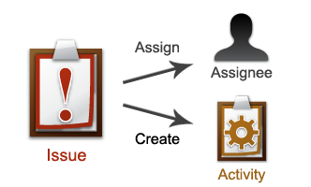
Known issues and future enhancements
Issues
There is a major lack of security. As it stands anyone could have access to anything within this business.
There could be more views that would help to implement better structure.
Joins could be more meaningful.
Enhancements
Adding much better joins that have more meaning to the business.
Adding more views to better enhance the functionality of the business
Adding views can also be used for implementation of tighter security so not everyone has all access everywhere and Top Secret is actually Top Secret.

